Slide 1
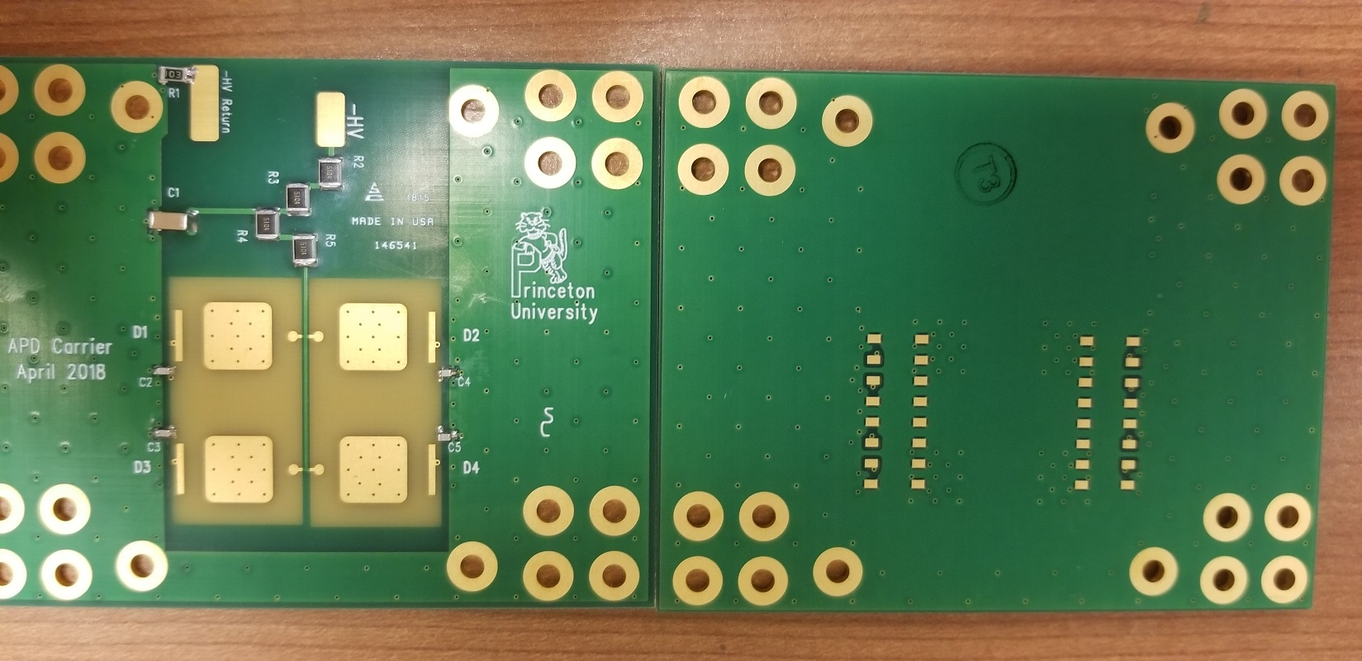
10/4/18 K. McDonald
Proposed “trench” to isolate the ground pad of an APD, and connect it to the B pin via a cap, as per M. Newcomer.
To be done to two APD pads on one carrier board
Do we need to remove these 3 ground pads?
Proposed “trench”
A pin
B pin
Cap from B pin to via

